Slide 1
Welcome to Horncastle Community Primary School

Slide 2
Let’s have a look around our Nursery setting!

Slide 3
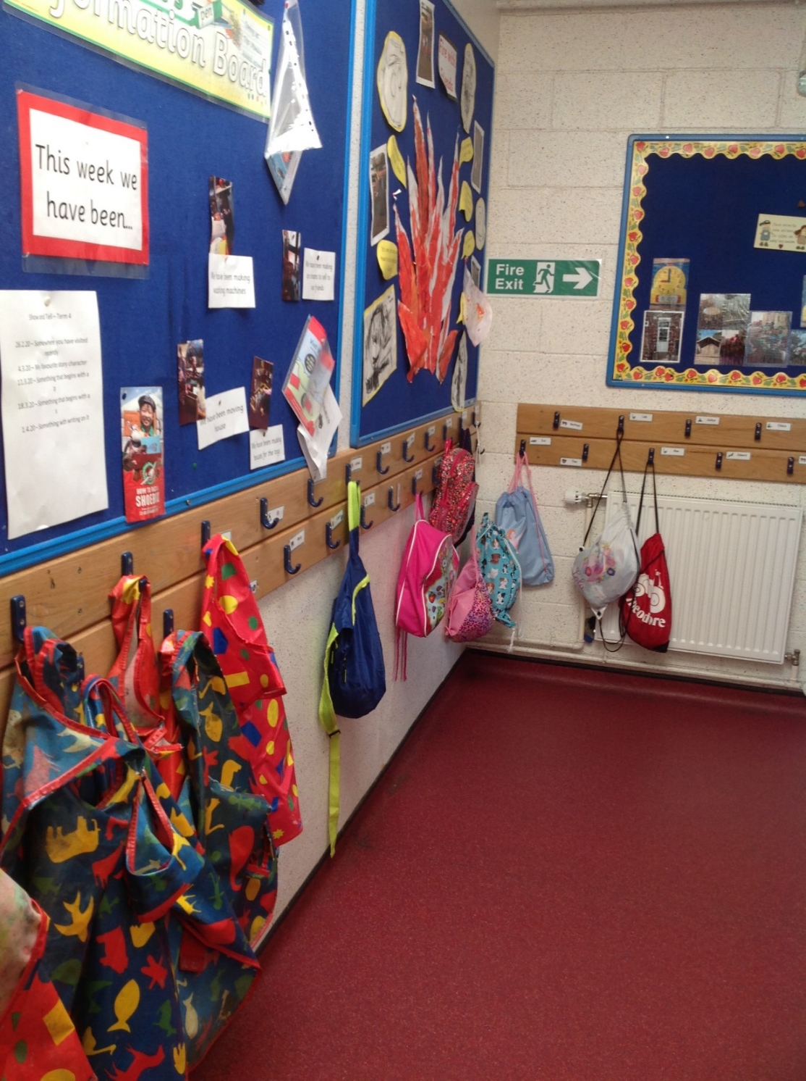
When you come into school, you will hang up your coat and bag on your own peg in the cloakroom.

Slide 4
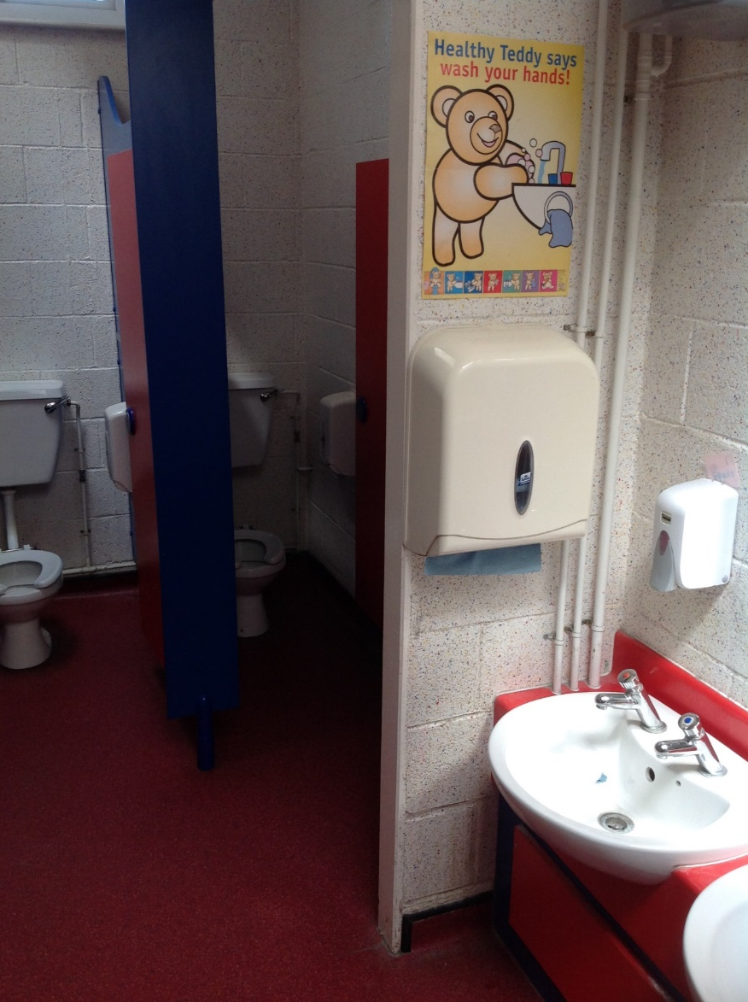
In the cloakroom, we have our toilets and sinks to wash your hands.

Slide 5
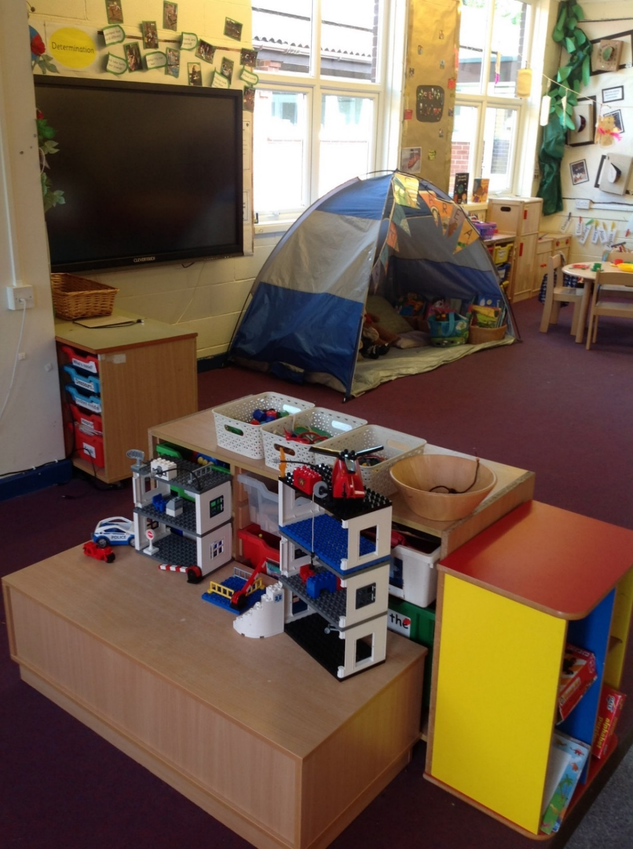
Welcome to the Nursery classroom

Slide 6
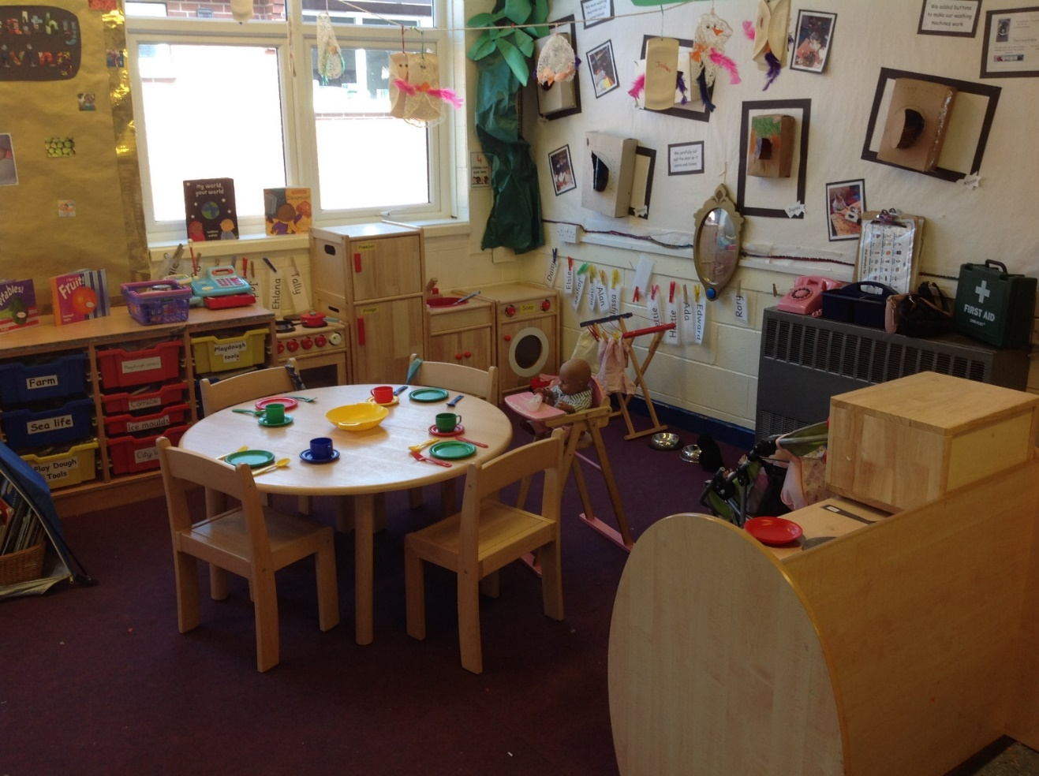
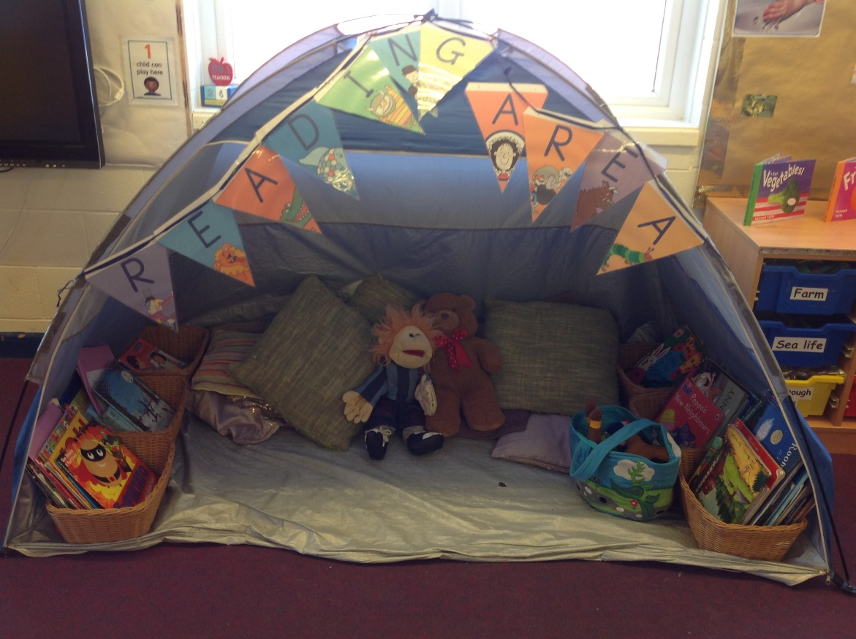
Reading
Area
Role Play
Area

Slide 7
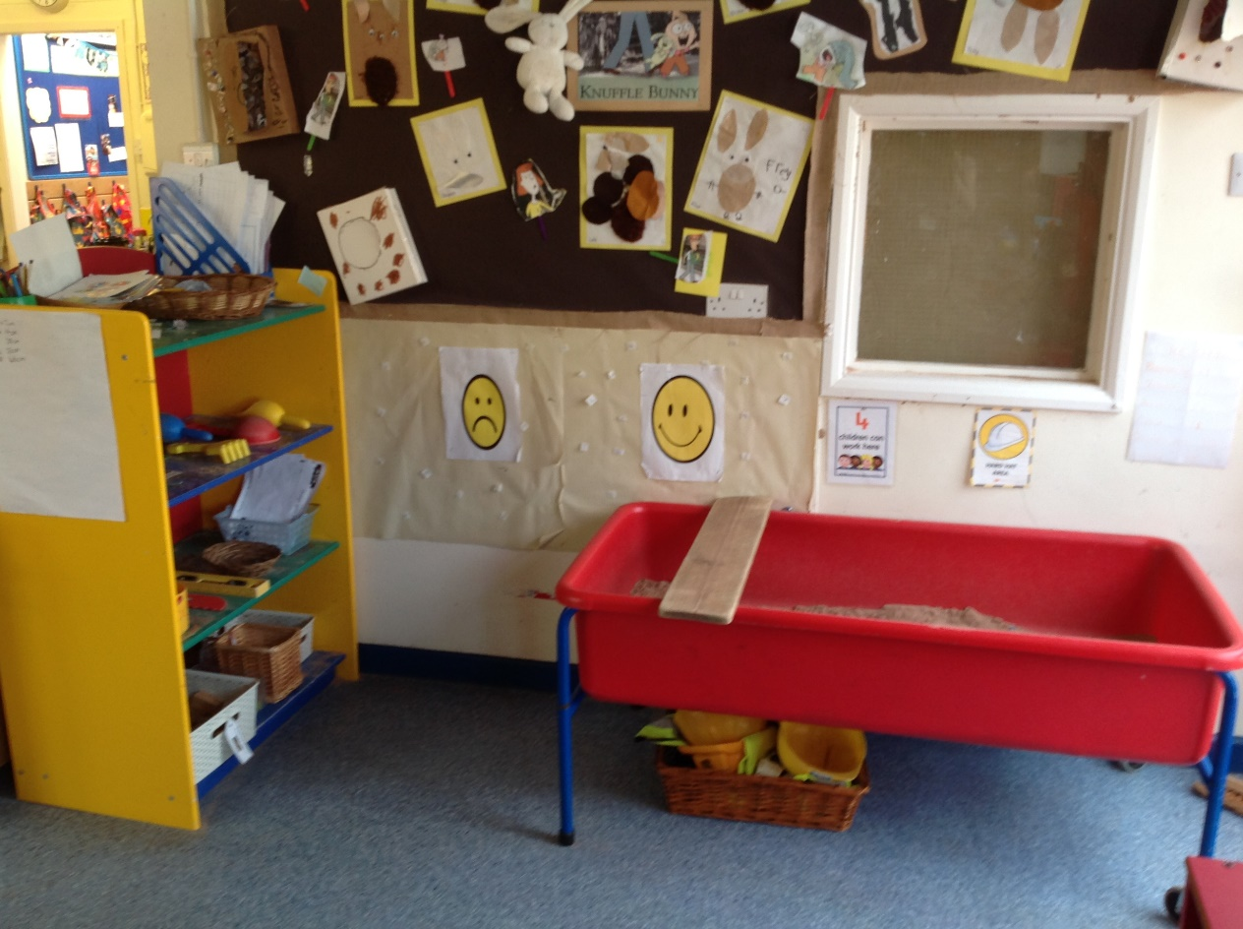
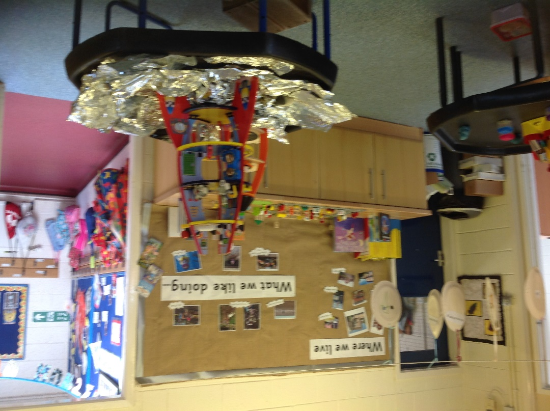
Investigation
Tuff Spot
Sand Tray

Slide 8
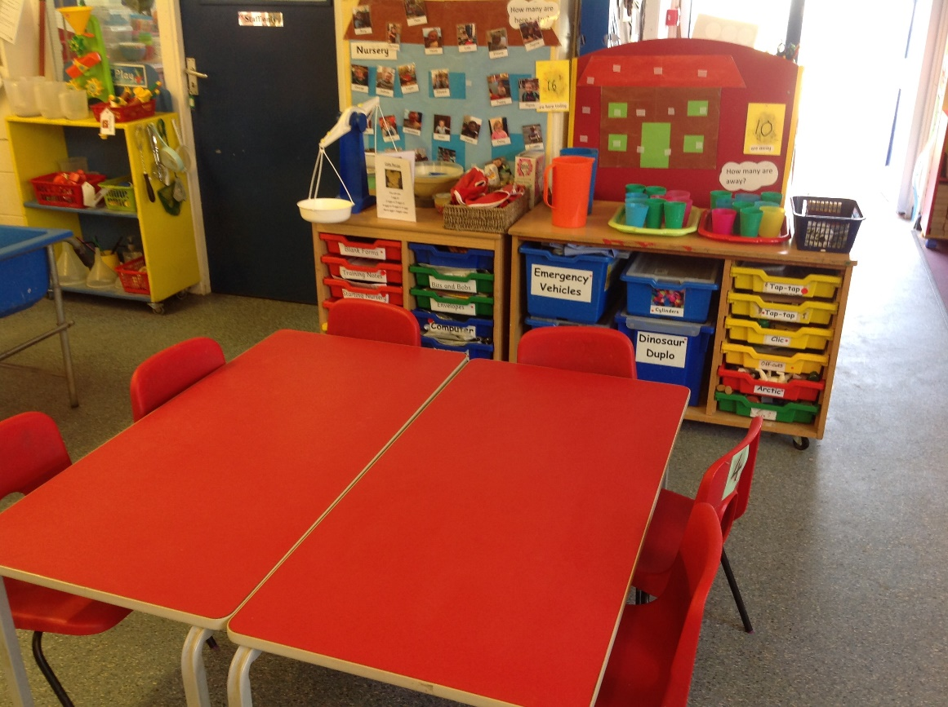
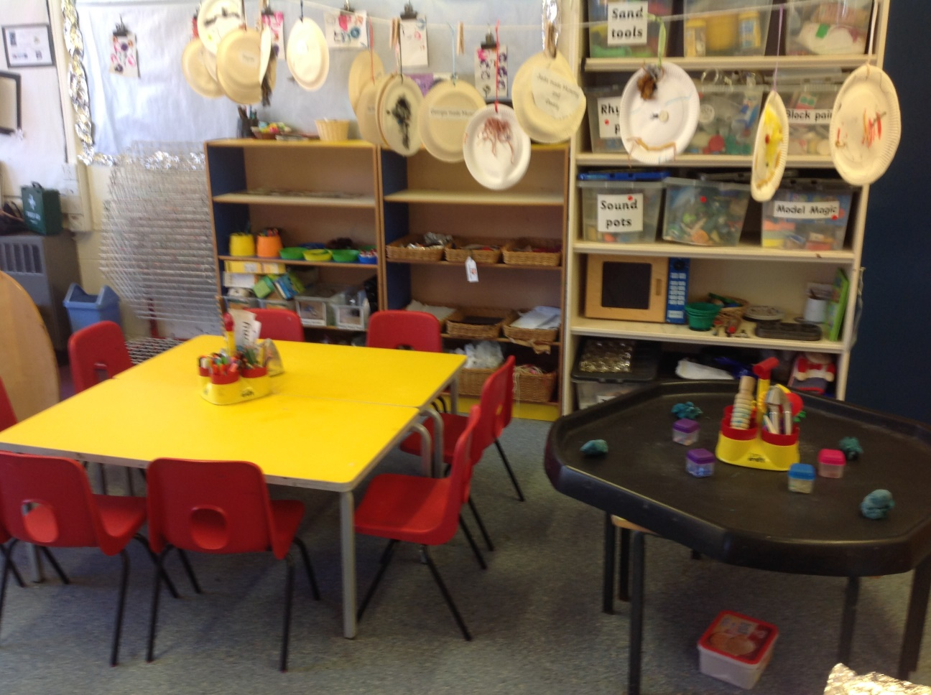
Creative
Area
Snack
Area

Slide 9
Let’s take a look at our fantastic new Outside Classroom!
We are really excited to play out here!

Slide 10
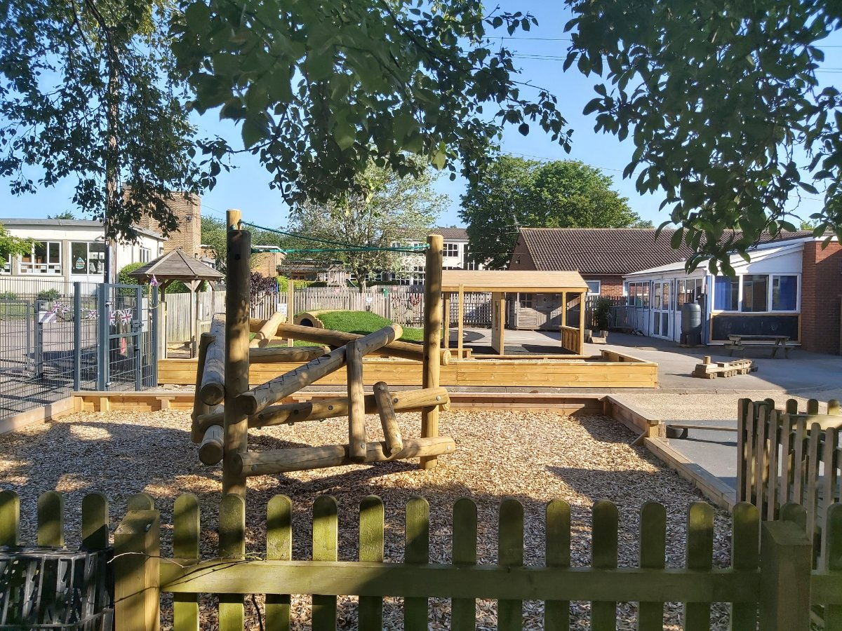
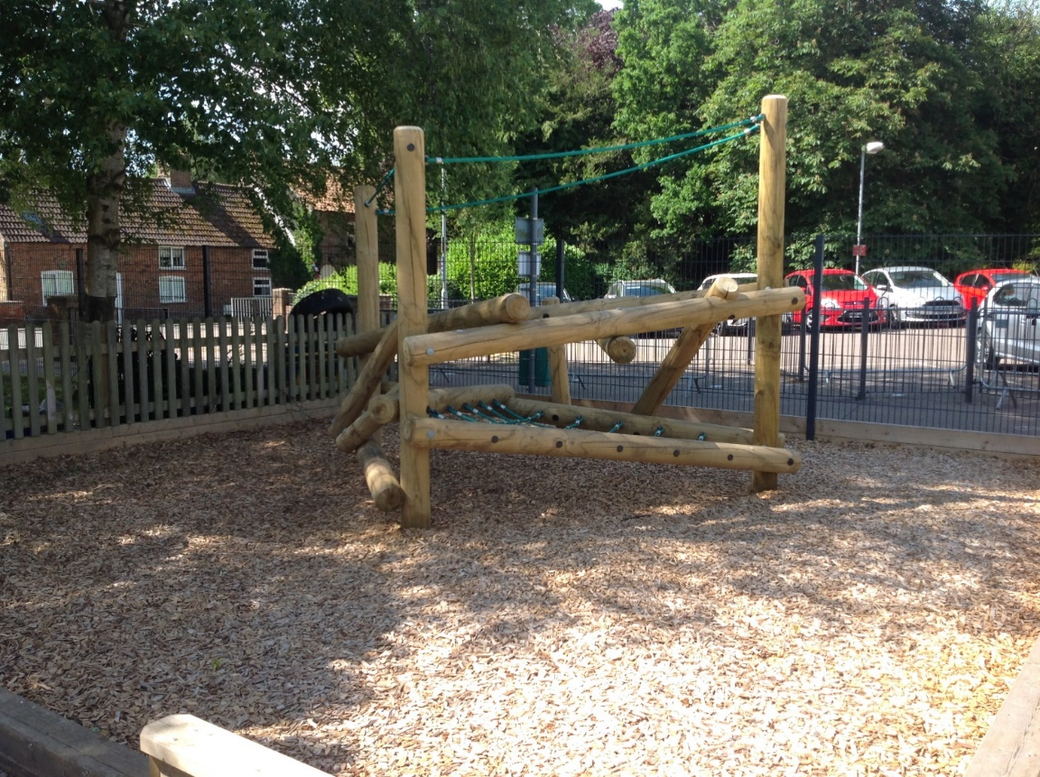
Climbing Frame

Slide 11
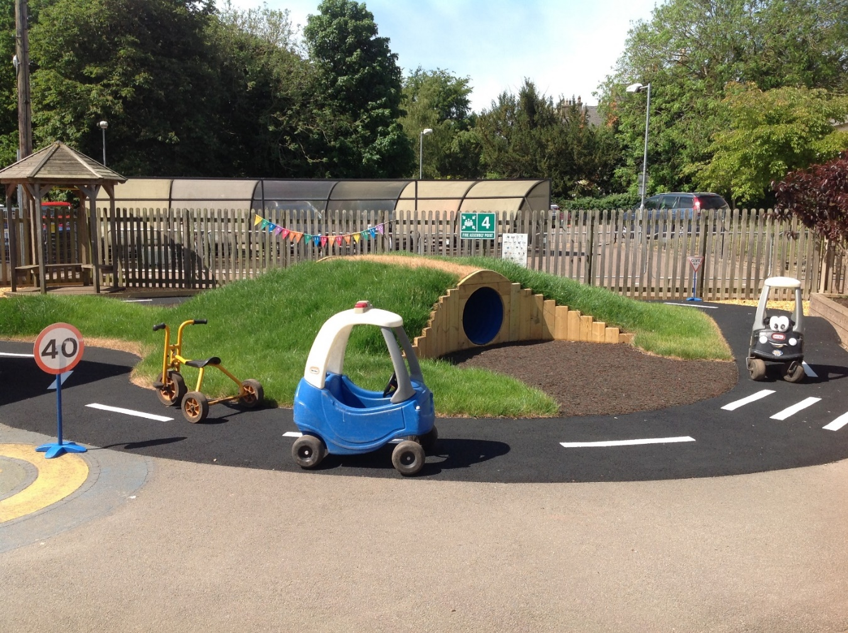
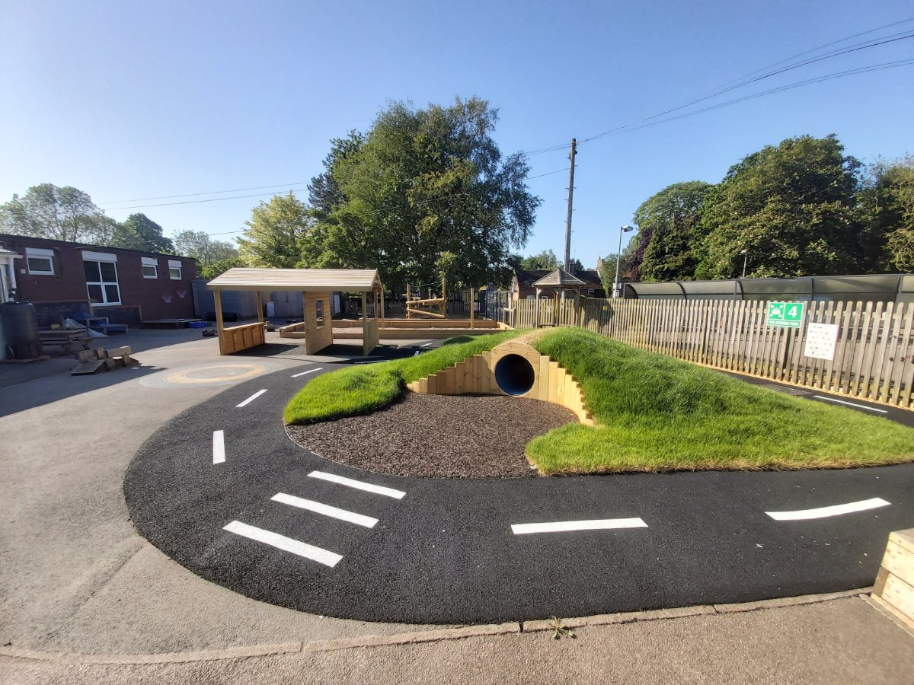
Tunnel
Car and Bike Track

Slide 12
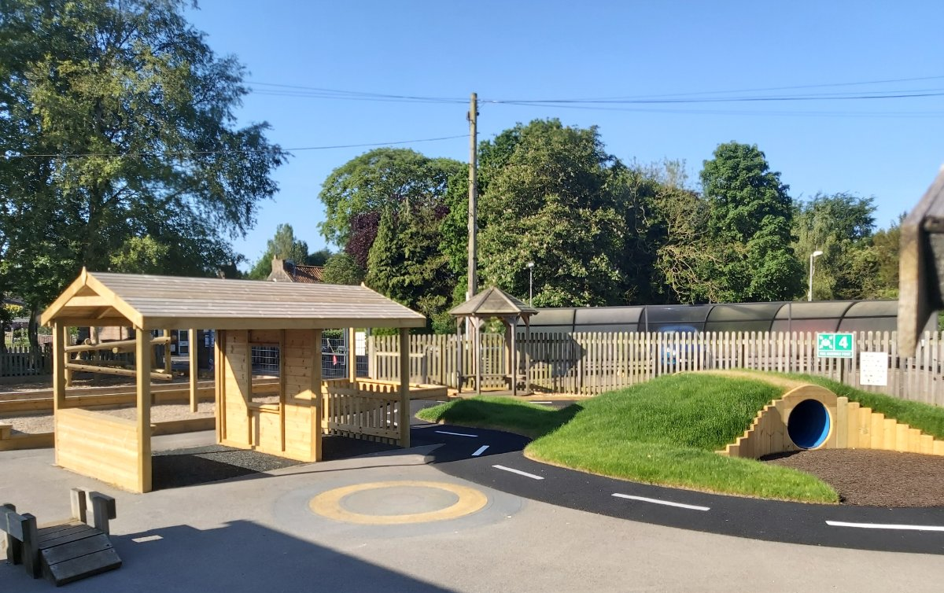
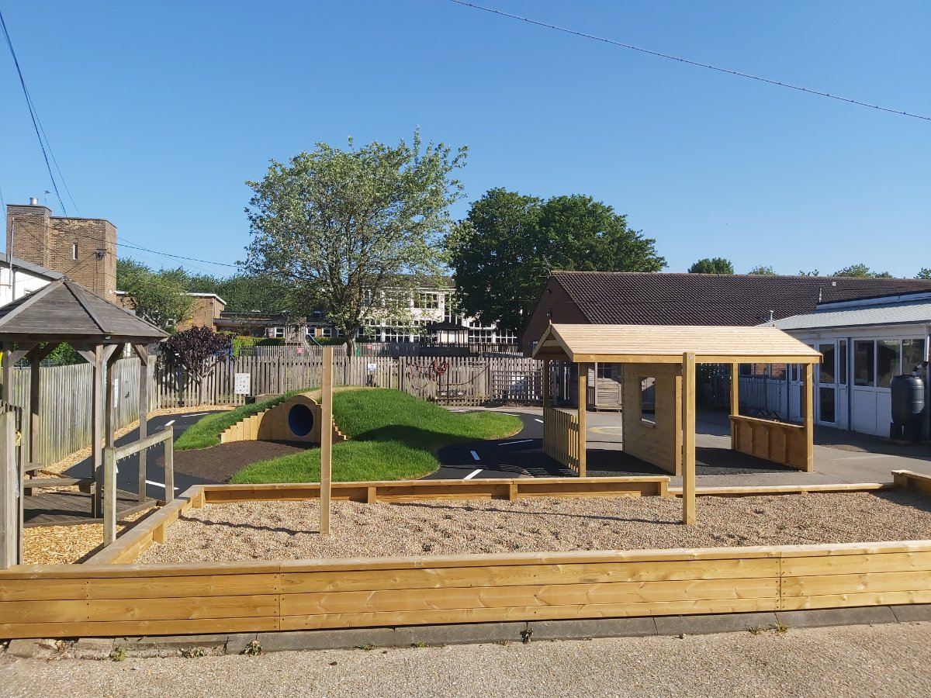
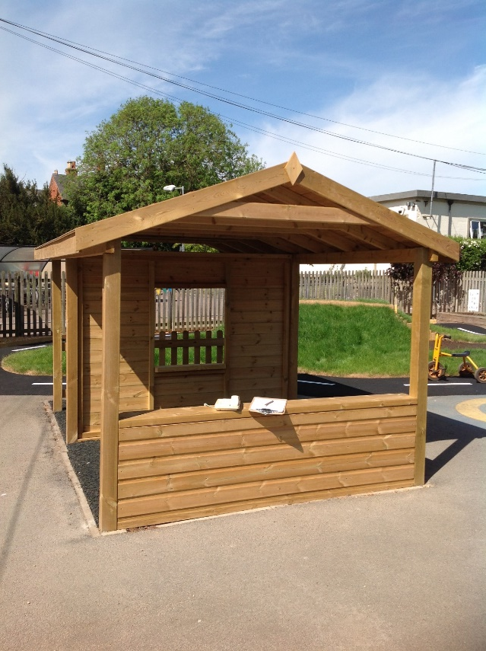
Gravel Pit
Role Play
Shed

Slide 13
We hope you have enjoyed looking around our setting!
We hope to see you very soon.
The Nursery Team

